Slide 1
Lytho
How to:
Launch, Review, and Manage Marketing Projects

Slide 2
Personalized Settings

Slide 3
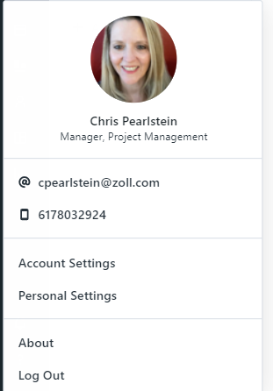
Personalized Settings
Go to your avatar in the bottom left corner and choose personal settings
  Update your profile
  Change your password
  Manage your time zone preferences
Set your notification preferences on requests and reviews
  In app or email or both – your choice
Set up the frequency you are notified

Slide 4
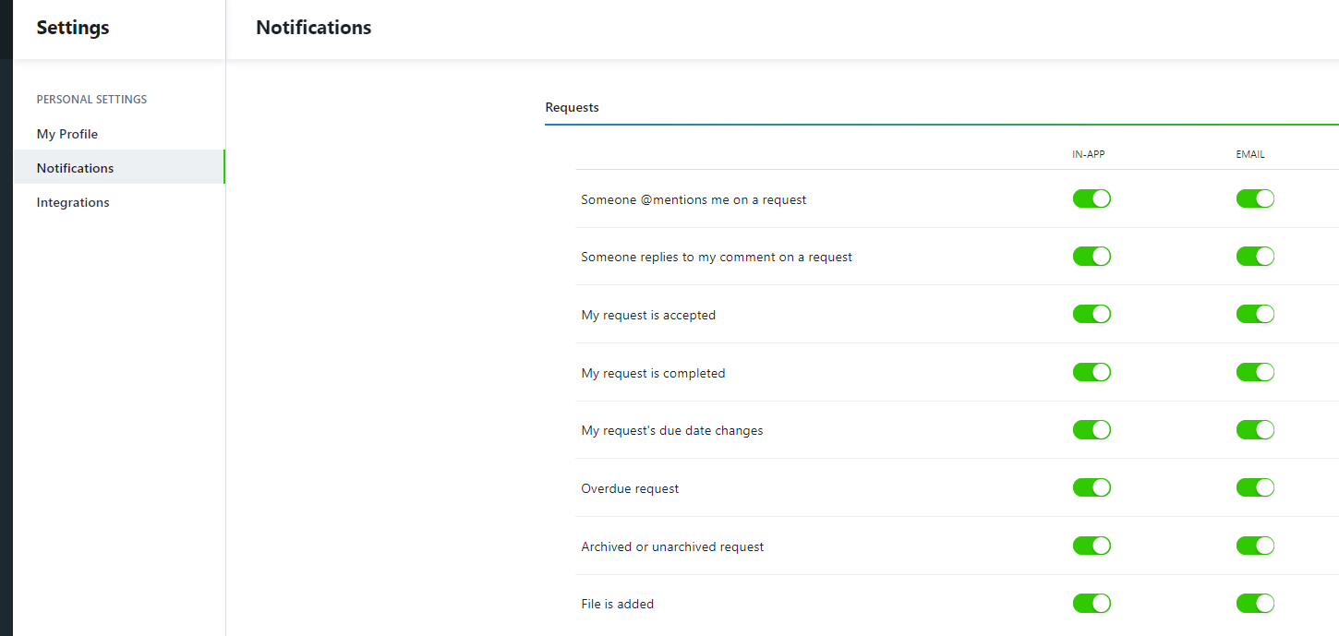
Personalized Settings – Notifications on Requests

Slide 5
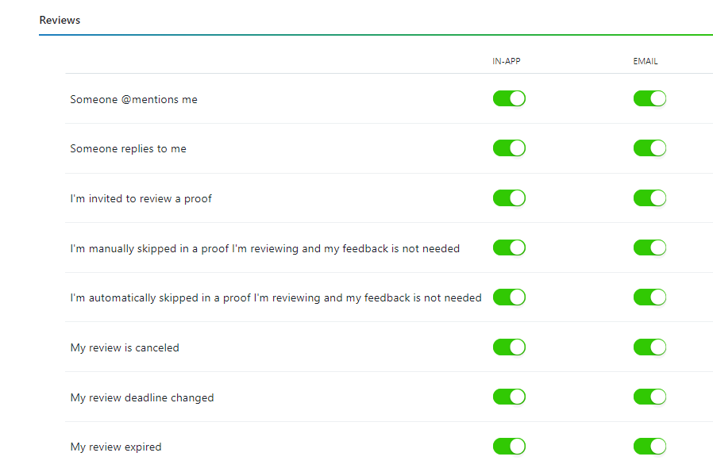
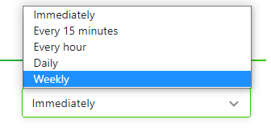
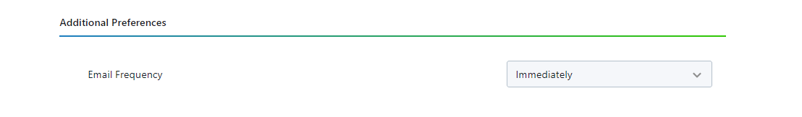
Notifications on Reviews

Slide 6
Dashboard and Forms

Slide 7
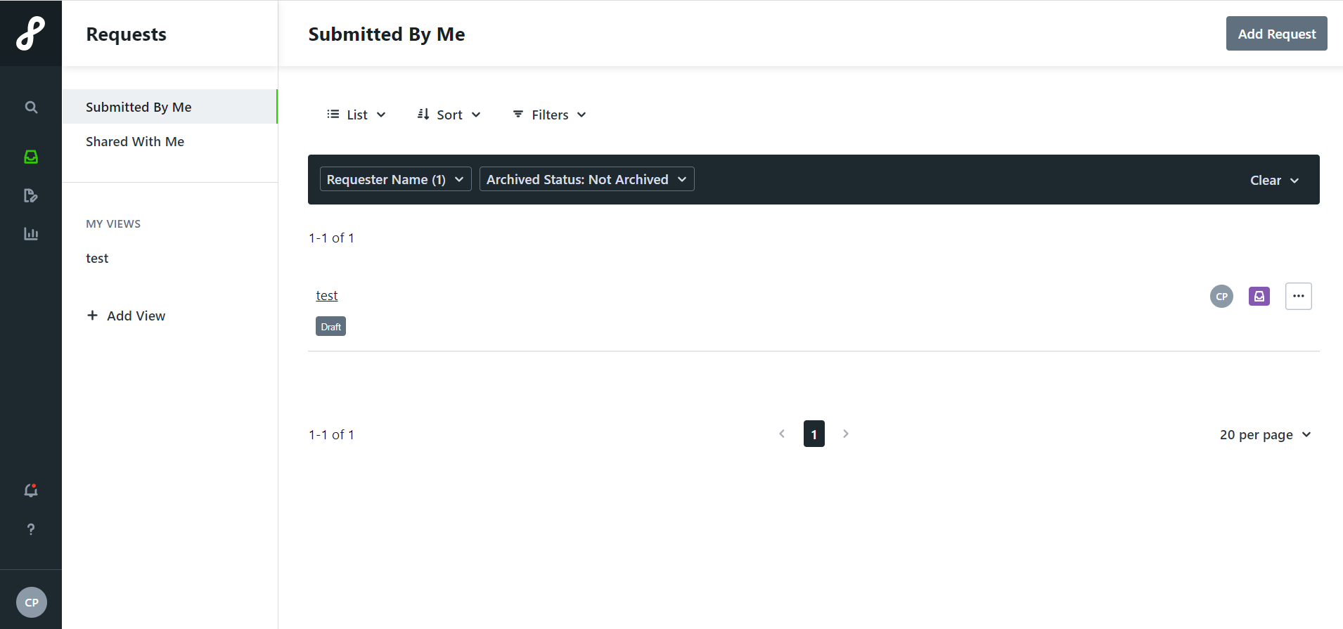
Dashboard

Slide 8
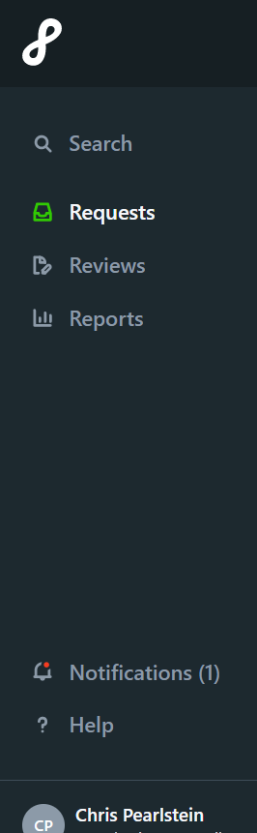
Dashboard
Global Search – Including Archive Projects
Reviews
In-App Notifications
Real-time Reporting
Personal Settings

Slide 9
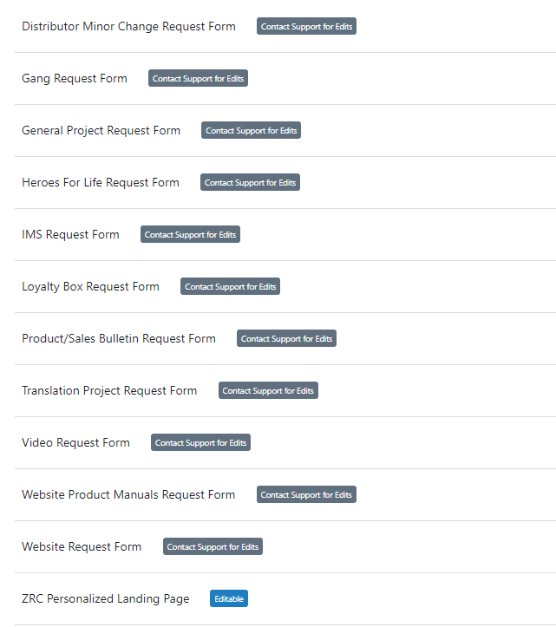
Forms
Note: Form availability is dependent on market use. Forms are customizable based on goals and usage.

Slide 10
Submitting a Request

Slide 11
Types of Projects
Digital
  Eblast, Landing Page, Clones
  Social Media
  Youtube
  ZRC
Print Materials
  Poster, Flyers, Postcard, Mailers, Promo Items
  Tradeshow Graphics
  Imagery
  Illustration
Product/Sales Bulletins
Translations
Video
  Animation
  Video Motion Graphics
Website
Note: Multiple project types can be submitted under one request.
Also, multiple project requests can be submitted and linked together under a single campaign.

Slide 12
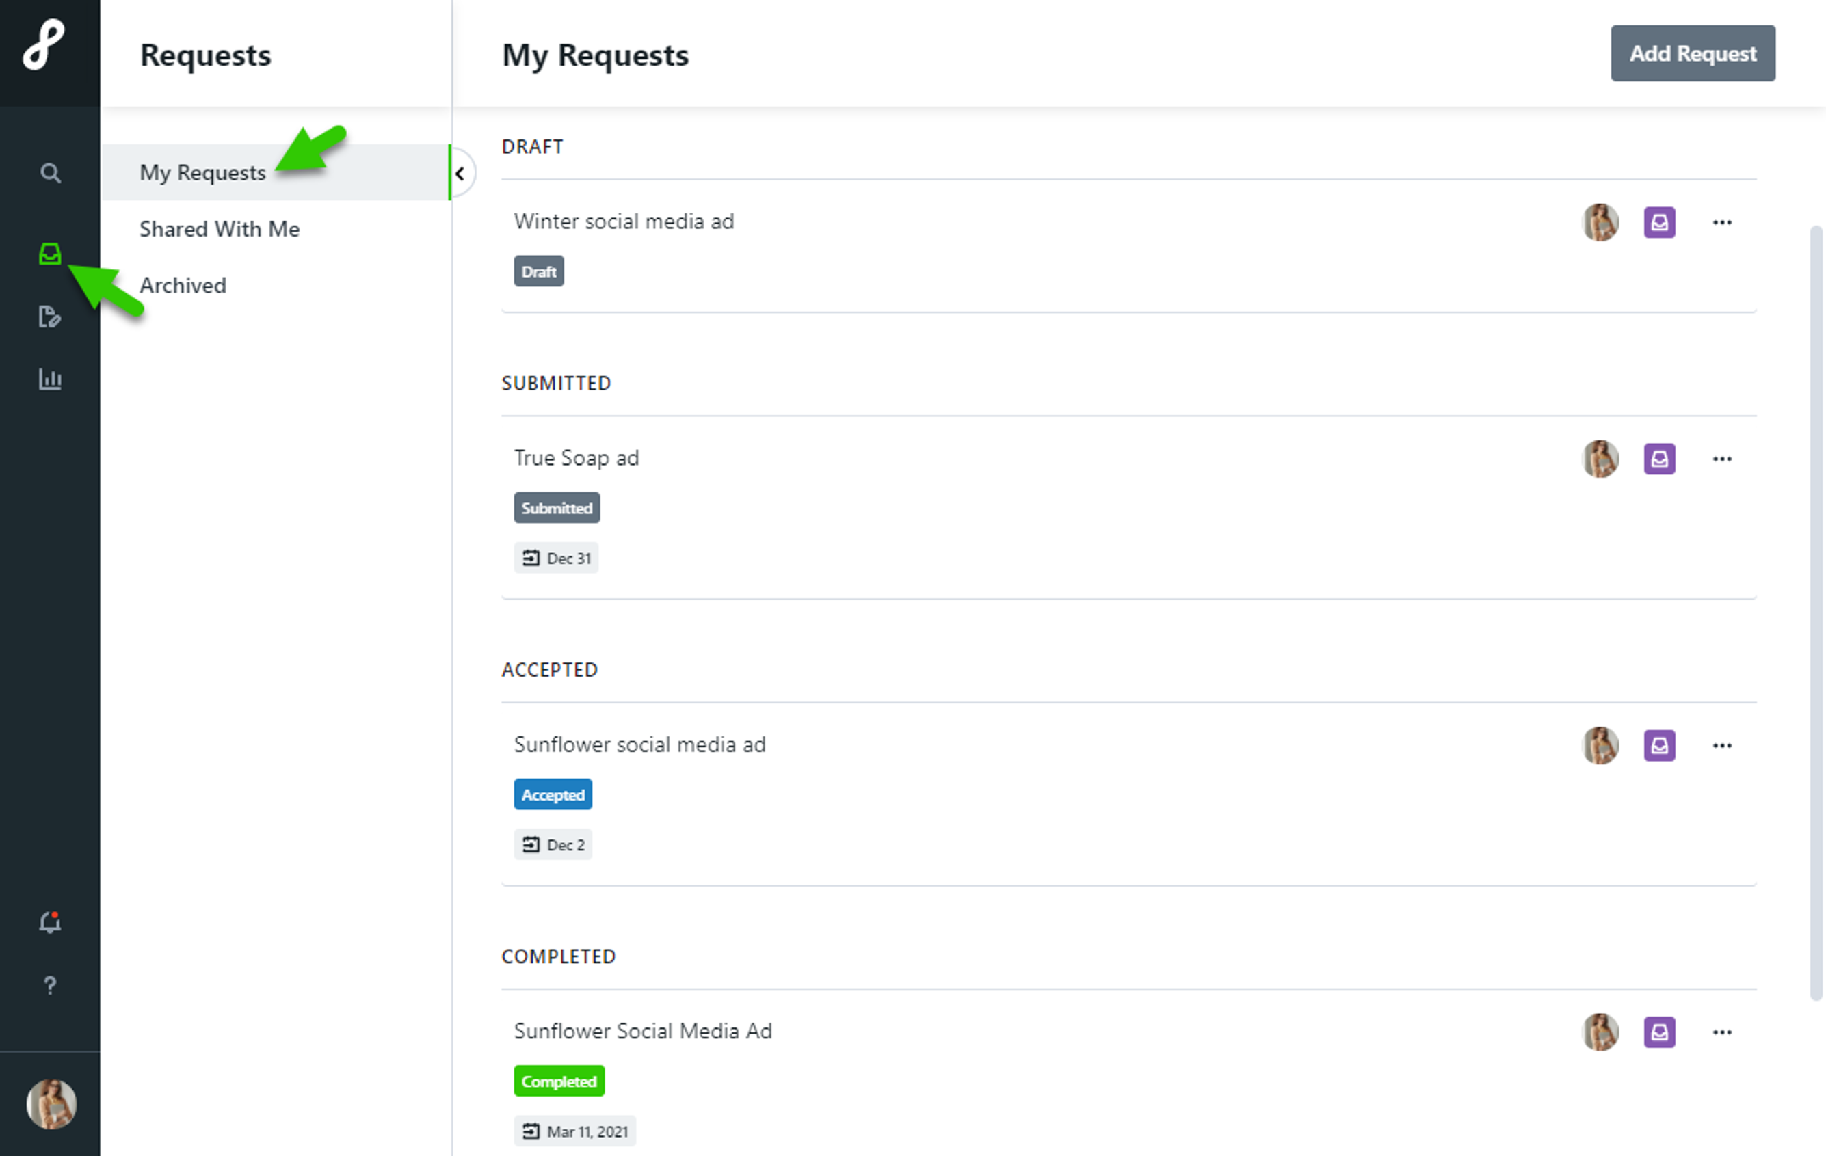
Project Requests
A request is a new job or brief that outlines the requirements of a project or initiative
There are different types of project requests in Lytho. Each type has its own requirements.
Complete and accurate information is Key
Use Lytho to make changes to the project, see who is working on your project, and to follow its progress.
Requests may appear in the following sections:
DRAFT - Requests that you have started but not yet submitted
SUBMITTED - Requests that you have submitted but have not yet been accepted
ACCEPTED - Requests that you have submitted and have been accepted
COMPLETED - Requests that you have submitted that have been completed and not yet archived

Slide 13
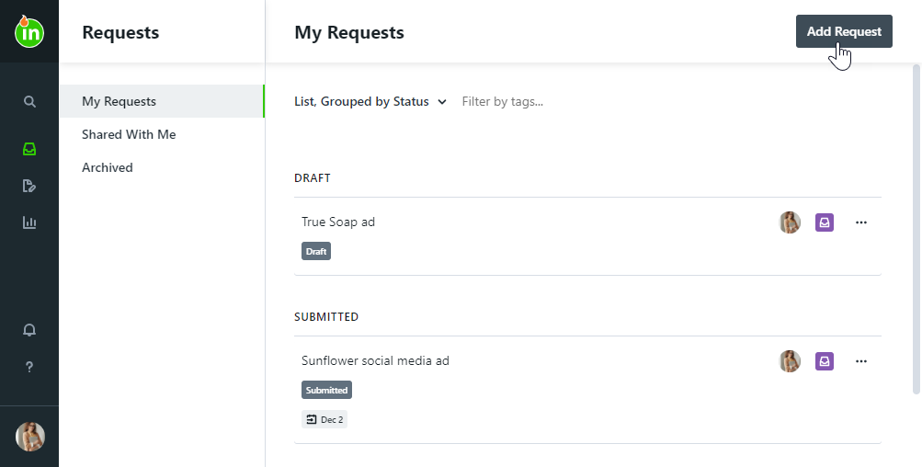
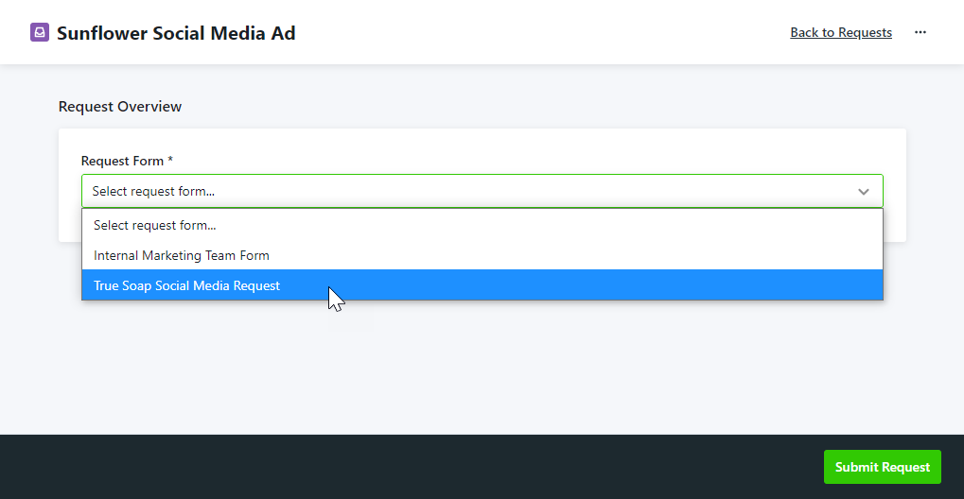
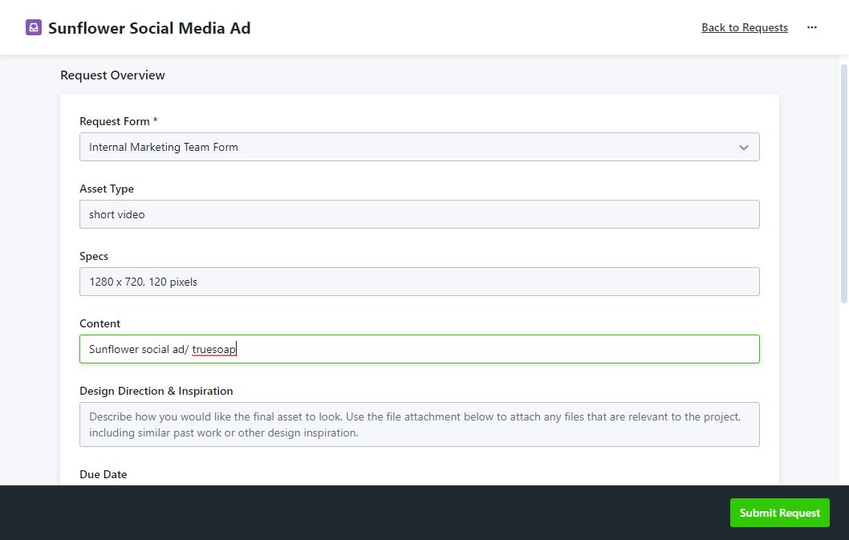
Creating a Request
To begin a new request, select the Requests icon from the global navigation menu. Click Add Request in the top right-hand corner of the screen.
Enter a name for your request and select Create Request.
Choose the form most applicable to your request.
Once selected, the form will populate. Complete the request form in detail and be sure to fill out all fields, including any supplemental attachments.
Your request data is automatically saved as you fill out the form. Any forms that are not yet submitted will appear in Draft status.
Click Submit Request to finalize your submission.
Once you have submitted your request, you will see the Request Details, where you can view the status of the request, modify the request, and collaborate with relevant team members

Slide 14
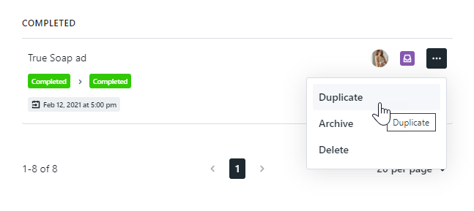
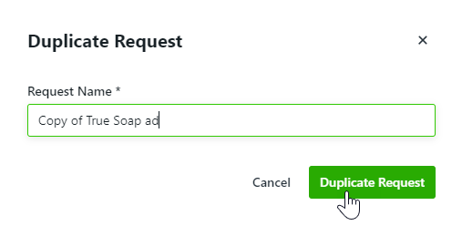
Duplicating a Request
Duplicating requests is a great way to cut down on repetitive work if you are requesting similar deliverables often.
From your requests list view, click the actions menu to the right of the request you would like to duplicate and select Duplicate.
You will be prompted to create a new request name. Select Duplicate Request when complete.
Your new request will be in your Draft section where you can update any information and submit when ready.

Slide 15
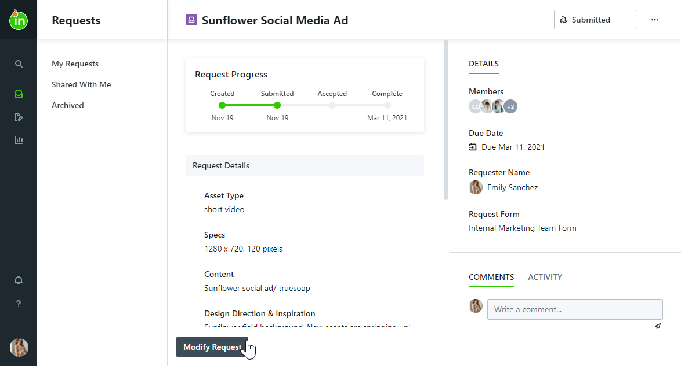
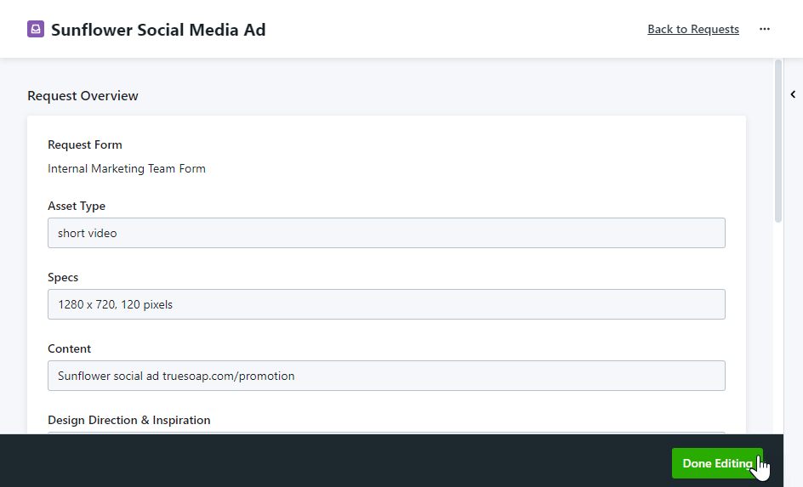
Modifying a Request
You can only modify a request in a status of Draft or Submitted.
Once the request is Accepted, you will no longer be able to edit the request details. However, you can still collaborate with IMS.
To modify an existing request, select your request name from the My Requests list. From the request details page, click Modify Request near the bottom of the page.
Make any applicable changes to your request and click Done Editing.

Slide 16
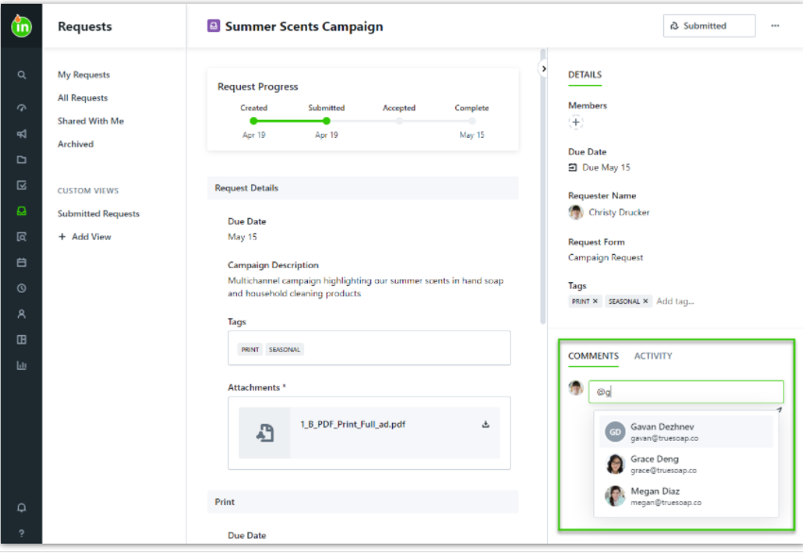
Sharing a Request
Action menu
Requests may be shared so that you can monitor progress or collaborate with others. View requests that have been shared with you in the Shared With Me tab.
Two ways to share a request:
1). Go to the Comment Box and begin by typing the "@" symbol and search by the first name of the person you would like to share the request with.
A user list will populate as you begin typing and you can click to select the appropriate user. The user's email address will display while composing the comment, and once posted, your comment will reflect their full name.
2. Go to the Action menu … top right and choose share. Pick the person and check their name.
Comment Box

Slide 17
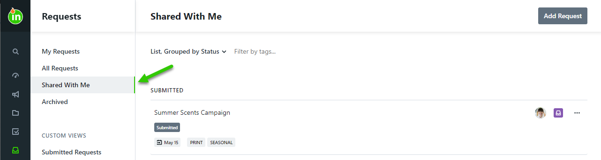
Viewing a Shared Request
When a request has been shared with you, you will be notified by in-app and email notifications. You will also be able to see the shared request in the Shared With Me view under Requests.
Users that have access to shared requests can collaborate on the request, duplicate the request, and download attachments and final deliverables.

Slide 18
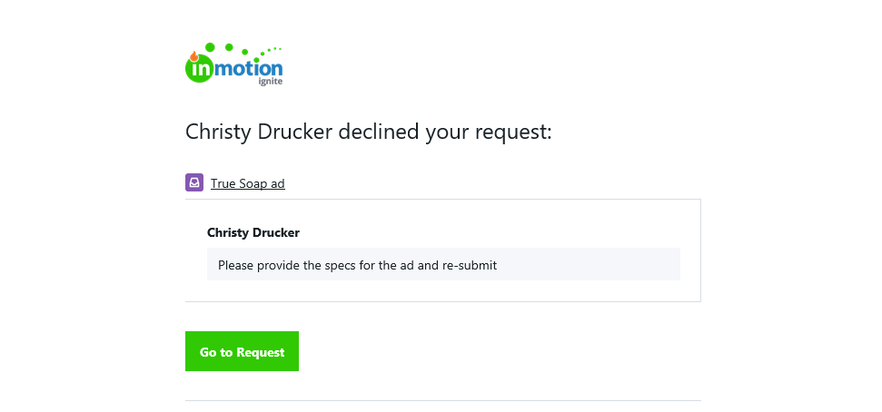
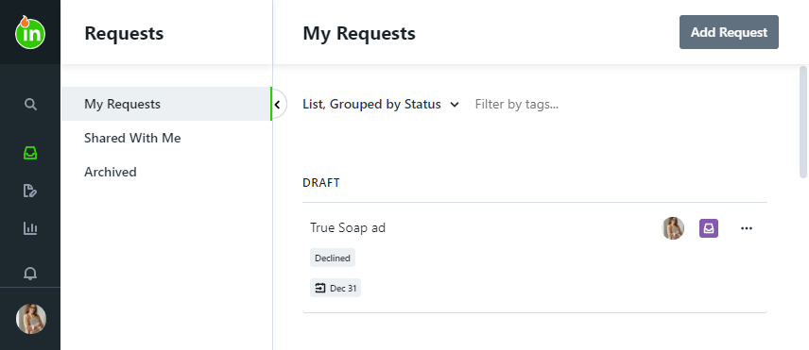
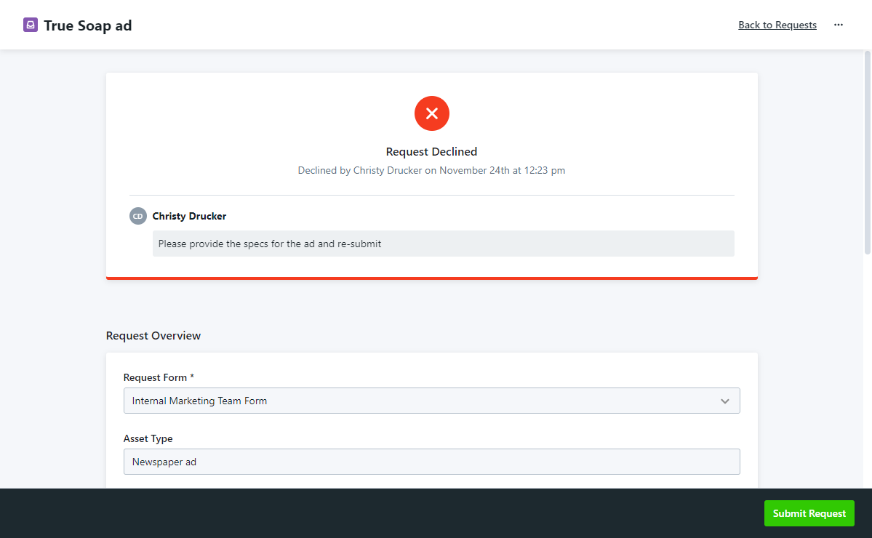
Declined Requests
Project Management has the option to decline a request and a reason will be given.
If your request is declined, you will receive an email notification including who declined the request and the reason.
Your declined request will be in the Draft section of your requests, with a badge indicating it was declined.
Click into the request to see the reason your request was declined and edit your request.
Once you have made the appropriate edits, click Submit Request to re-submit.

Slide 19
Managing Your Projects

Slide 20
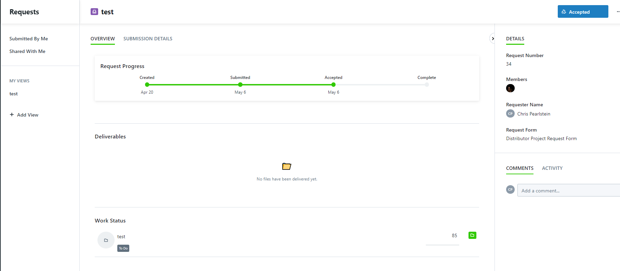
Accepted Request Details
Project Name
Project Status
Request Details
Comment Section for changes for queries and notes.
Final File Delivery For Download
Project Status
You cannot modify a request after it has been accepted. The best practice is to @mention the Project team (@projectmembers) in the comments box and all team members will be notified.

Slide 21
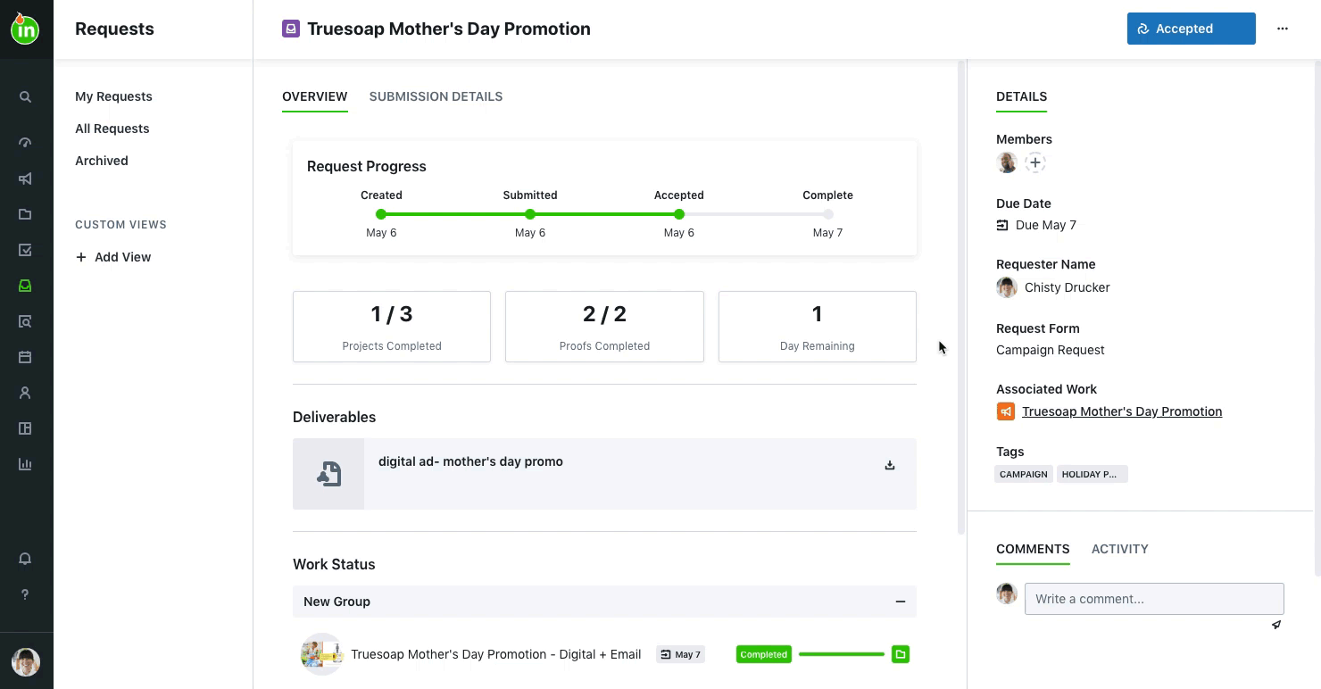
Project Status and Progression

Slide 22
Review

Slide 23
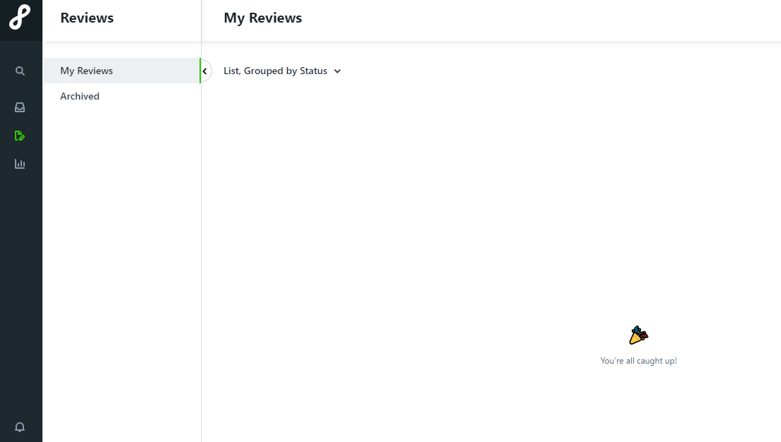
Accessing Your Review
Review Tab
3 ways:
  In APP Notification
  Email Notification
  Lytho Review Tab
Notifications

Slide 24
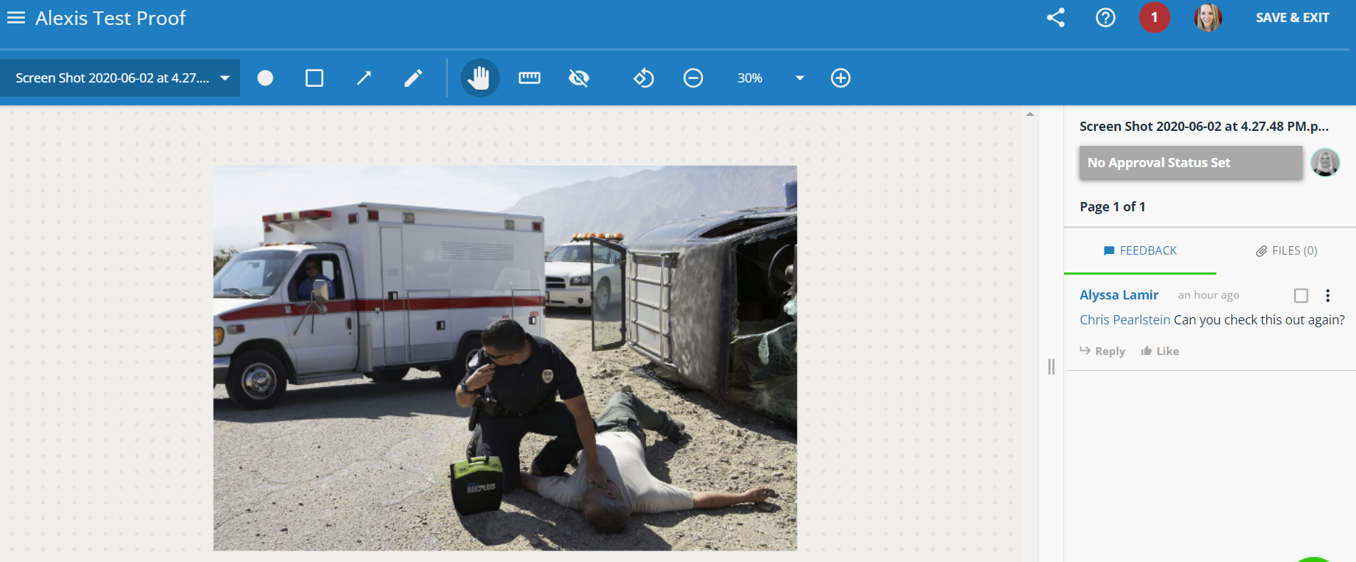
Review Space
Share Feature
Who is on the review with you
Tools to edit your proof
Review Proof Name
Choose an approval status on every page
Print
Download
Comments and Edits

Slide 25
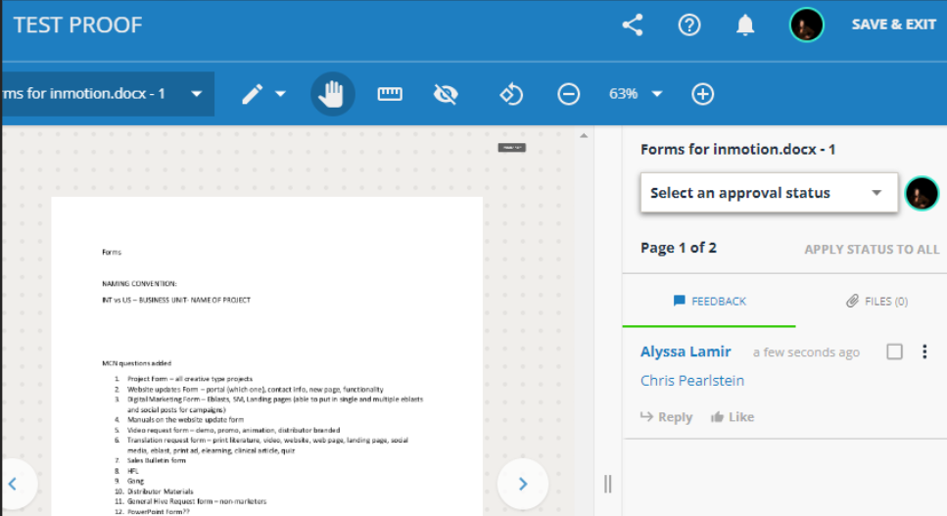
Review Space @Mention
You can add someone to a review by @ mentioning them in the comment box.
You can choose if they need to have an approval status or if they can just review and comment.
EVEN IF IT IS RETURNED!
@mention

Slide 26
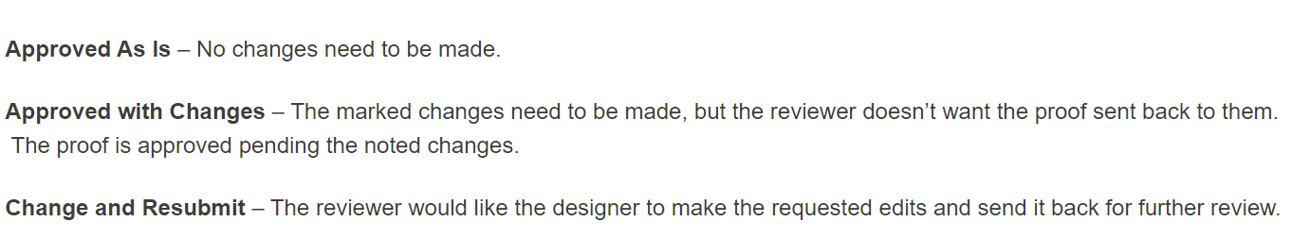
Approval Status

Slide 27
Review Process
https://vimeo.com/380579307/b950dc4b27

Slide 28
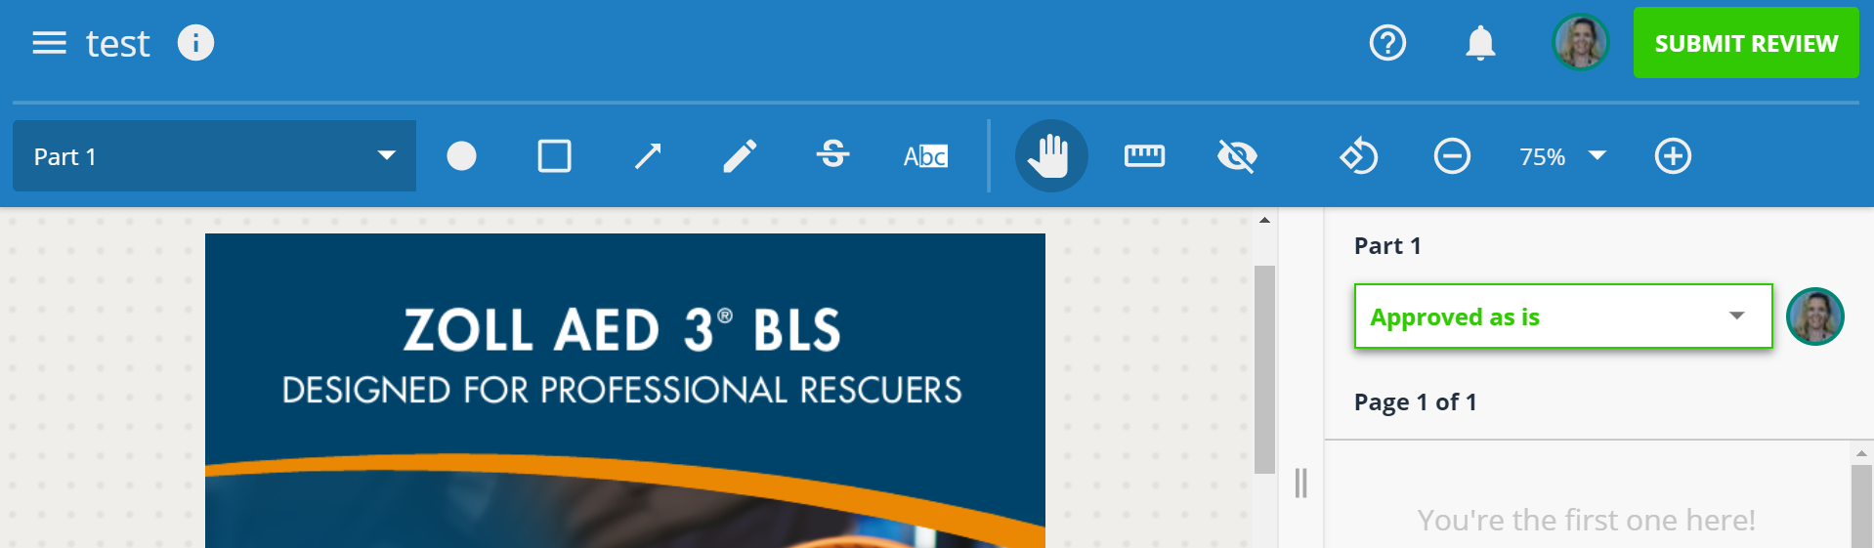
Submitting A Review
After selecting an approval status on every page, the green submit review button will show up in the top right corner

Slide 29
Final Asset Delivery

Slide 30
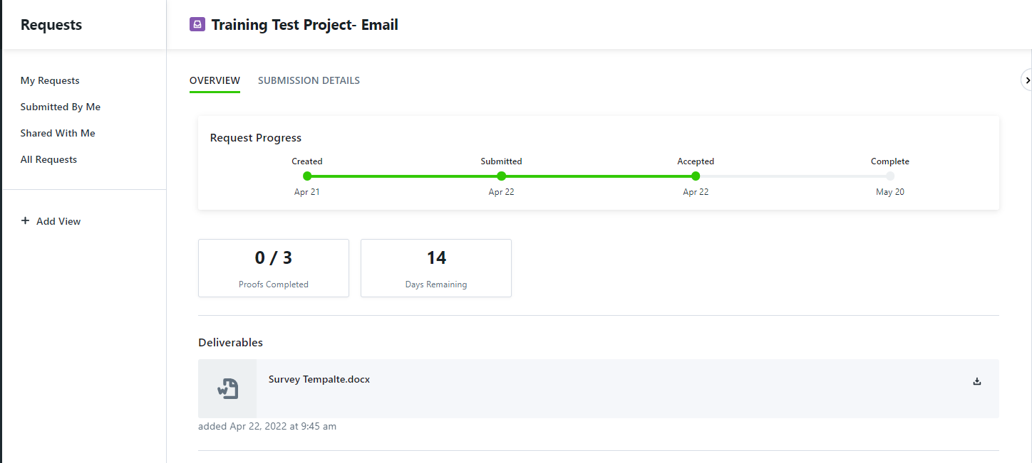
Final Asset Delivery
Final Delivery

Slide 31
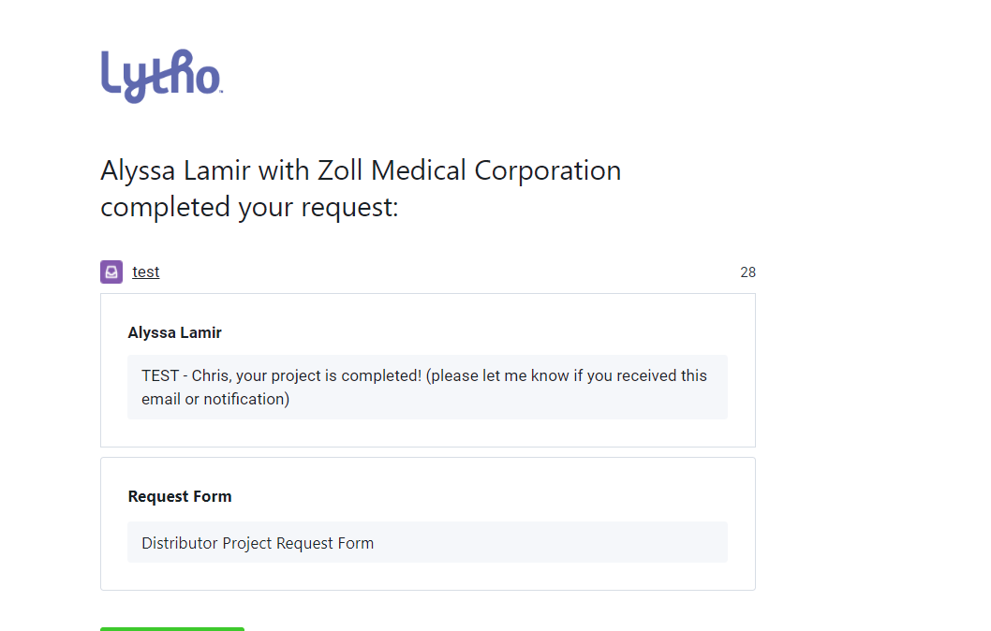
Final Asset Delivery – Email

Slide 32
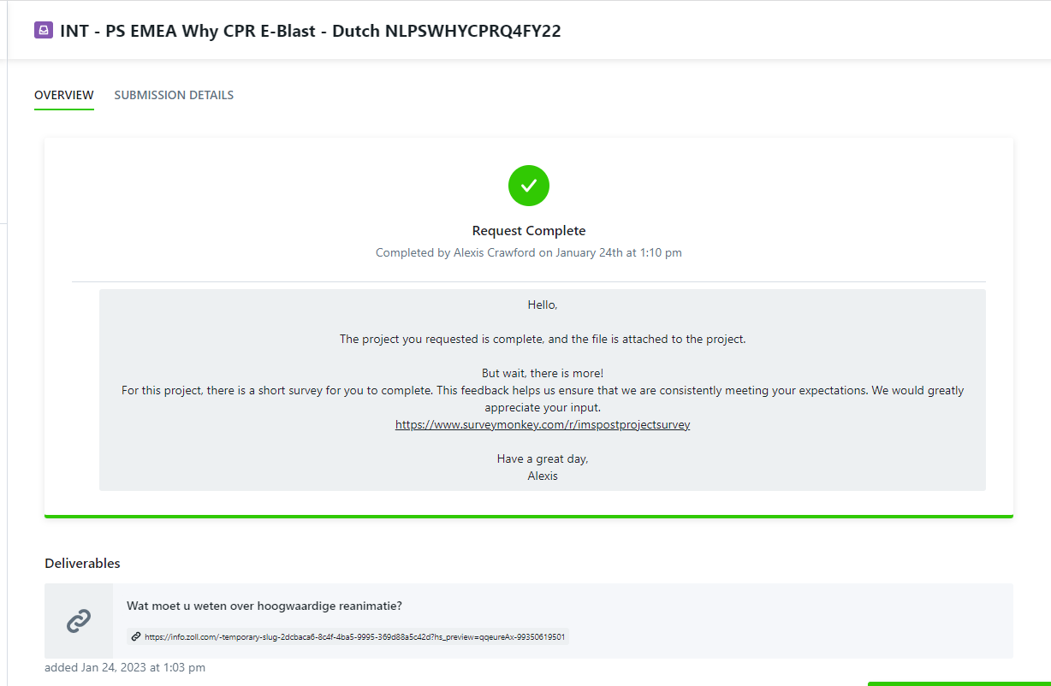
Project Completion
Survey Questions

Slide 33
THANK YOU

