Slide 1
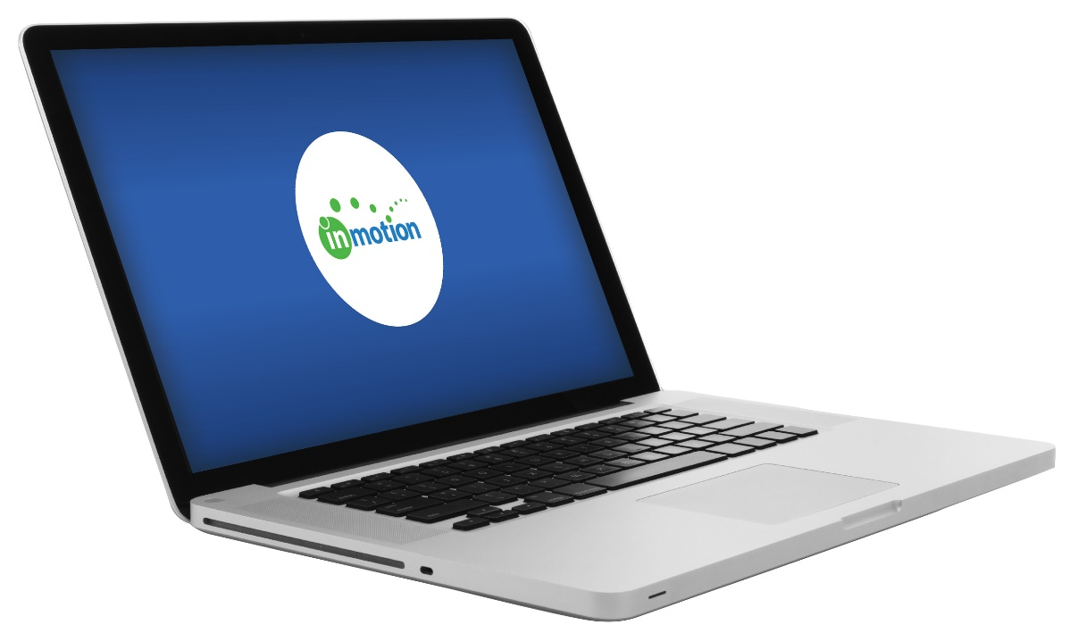
InMotion: Submitting
and Reviewing a Project

Slide 2
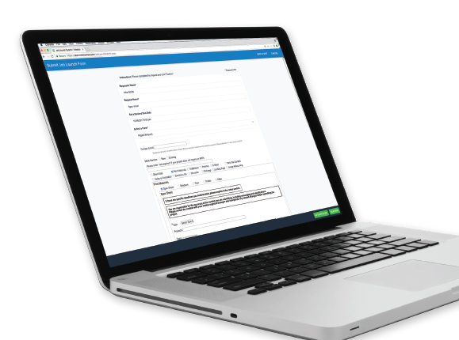
InMotion: How to launch and review a project
Explains how to launch, manage, and review your marketing projects through InMotion.

Slide 3
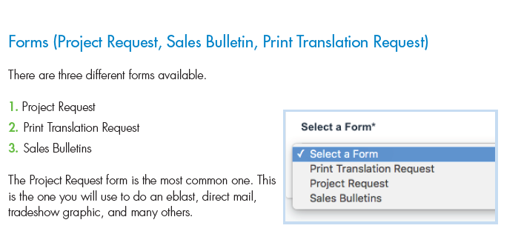
Types of projects in InMotion

Slide 4
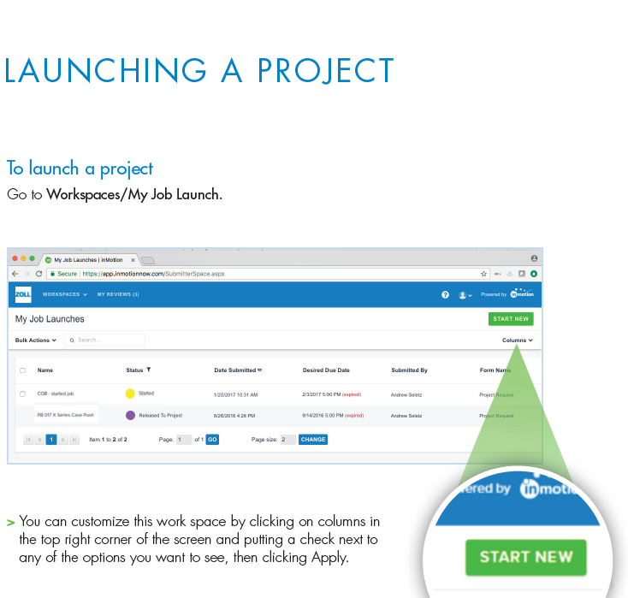
Launching a project
Different types of projects in InMotion. Each type has its own requirements.
Complete and accurate information
Use InMotion to make changes to the project, see who is working on your project, and to follow its progress.

Slide 5
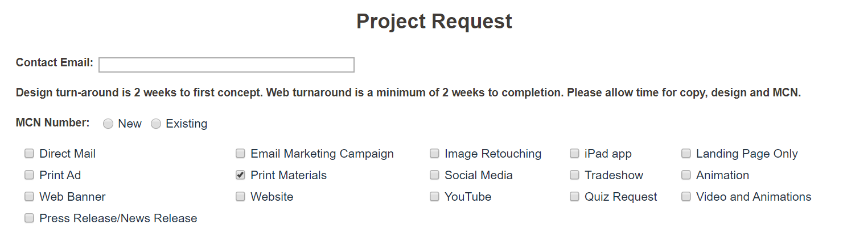
Project Type
You can choose multiple project types in one project request.

Slide 6
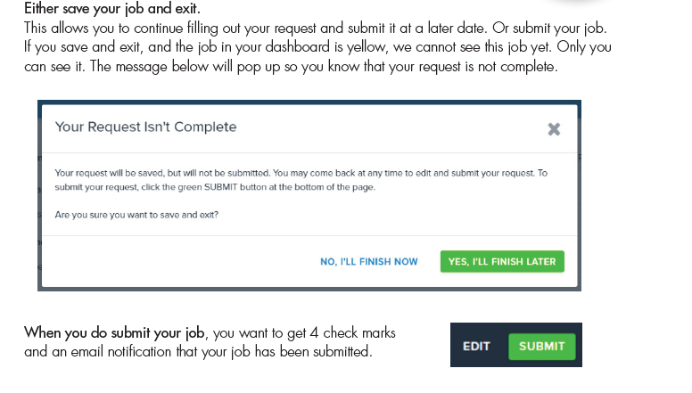
Save your project and begin later
Save your job and begin again later
What does that mean?

Slide 7
My job launch statuses
A request has been started by you but not submitted. You need to finish and submit it before IMS can see it.
Started
A request has been requested by you and it is in processing with Project Management.
New
Your request has been submitted and accepted. It has been assigned to a team.
Released to Project
You or someone on the team is making changes to the original request. It will need to be submitted again so that the team can see it.
In Revision
Your request has been rejected. An email has been sent to you with the reason for the rejection.
Rejected

Slide 8
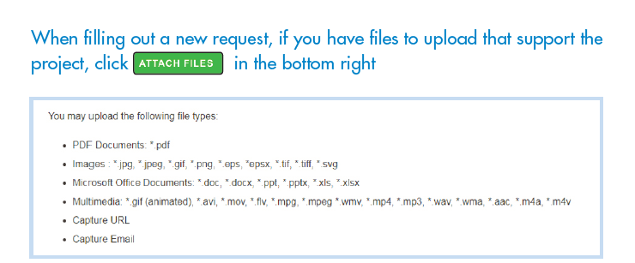
Add attachments to my request

Slide 9
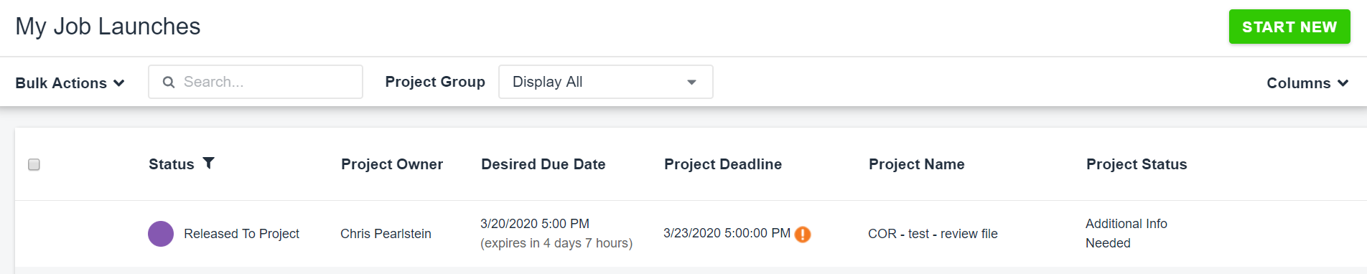
Checking on my project
Status – whether your project was accepted or not.
Project Owner – person with the most amount of work on your project right now – this can change
Desired Due Date – your requested date
Project Deadline – exclamation mark means your due date has changed
Project Name – this is what your project name has been changed to – use this in all email communication
Project Status – always changing, shows important information on your project

Slide 10
Reviewing proofs

Slide 11
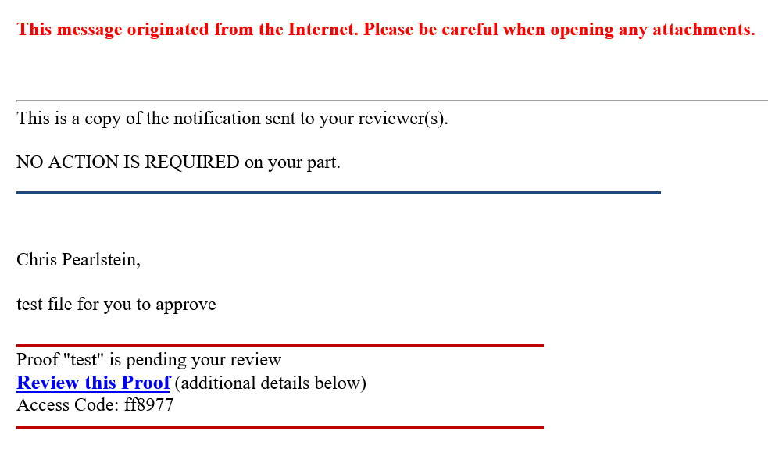

Accessing your review
Email called “Copy of Notification to Reviewer - Proof Available for Review - "test“sent with a link to your review
Or log into inMotionnow.com and go to the review tab

Slide 12
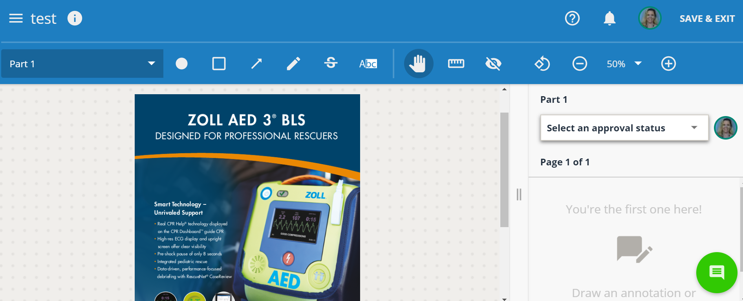
Provide Feedback
Who is on the review with you
Message from the designer
Tools to edit your proof
Make comments vanish
Versions
Print
Download
Choose an approval status on every page
Number of pages
Comments or changes show up here
Add a comment

Slide 13
What do I add to my review?
Specific comments and changes.
Do not add questions
Add a new word document as an attachment if you have a lot of comments and changes
Add a new picture to your review if you want one

Slide 14
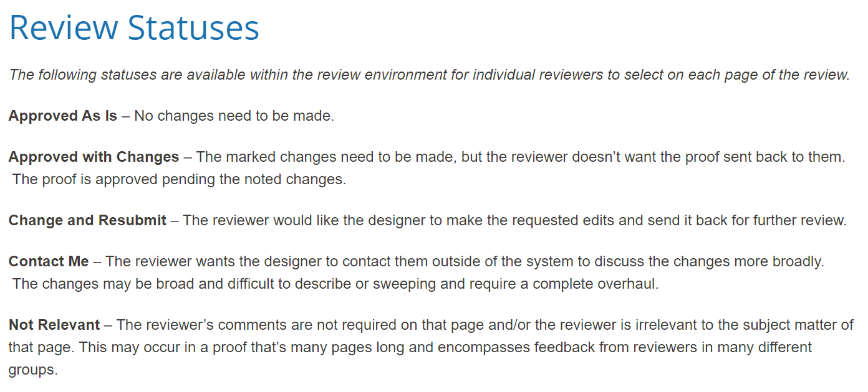
Approval Status

Slide 15
Approval Status - continued

Slide 16
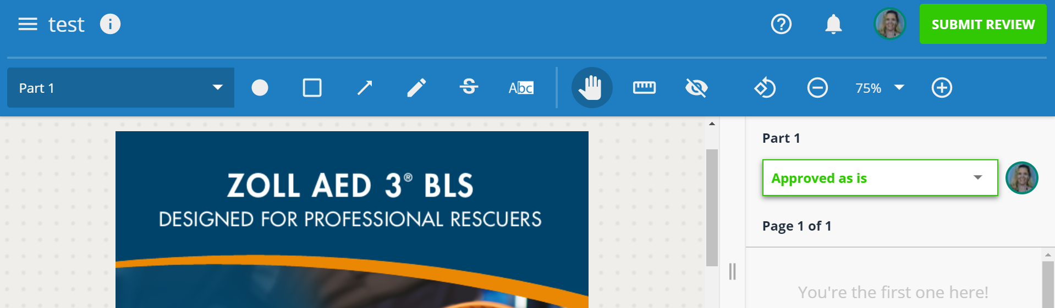
Submit my review
After selecting an approval status on every page, the green submit review button will show up in the top right corner

Slide 17
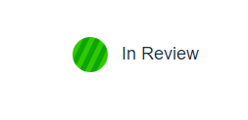
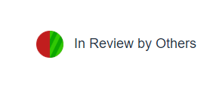
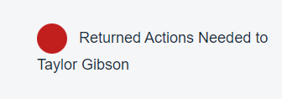
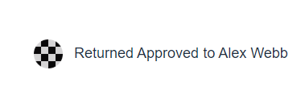
Reviews
If your review is still open it will be a form of green circle and you still need to submit.
If your review is done but the proof is still open for someone else, it will be green and red.
If the proof is returned by everyone with changes it will be red.
If the proof is returned by everyone approved as is, it will be black and white.

Slide 18
Questions?

